Slide 1
Software Testing Presentation
Dejeon Battick
Shemar Henry
Shemar Lundy
Mark Antony Jones

Slide 2
Content
About the Application
Use cases
Type of testing perform
The Espresso framework
Test cases
Summary
Other Testing frameworks
Questions

Slide 3

Transaction Tracker by TPGD
The app in question is a personal money manager application.
Allows users to keep track of their daily spending and over all expenses
Use Cases :
Manage Transactions
Monitor Expenses
Calculate cost
Make stochastic decisions
Adding Expenses
Graphical Representation of Expenses

Slide 4
Use Case
Add transaction
Delete transaction
Edit transaction
Delete all transactions
Cancel transaction
Enter budget
Calculate lost of item
Add expense
Edit expense
Cancel expense
Delete expense
Generate graph

Slide 5
Espresso testing platform
The Espresso testing framework provides a set of APIs to build UI tests to test user flows within an app.
Used mainly for white box testing
Used within android studio through dependencies
Espresso Testing works basically in three blocks:
ViewMatchers – allows you to find an item in the view
ViewActions – allows to execute actions on the elements
ViewAssertions – validate a view state
Notes:
These APIs let you write automated UI tests that are concise and that run reliably. Espresso is well-suited for writing white box-style automated tests, where the test code utilizes implementation code details from the app under test.”

Slide 6
Successful Tests

Slide 7
Testing Method(s) Used:
Black Box Testing
Grey Box Testing

Slide 8
Add Transaction
Script
@Test
public void sucessfulAddTransaction() throws Exception{
onView(withId(R.id.fab)).perform(click());
onView(withId(R.id.enter_name)).perform(click())
.perform(clearText()).perform(typeText("t sirts"));
onView(withId(R.id.enter_quantity)).perform(typeText("20"));
onView(withText("ADD TRANSACTION")).perform(click());
}
Test Case was successful and application works as it suppose to

Slide 9
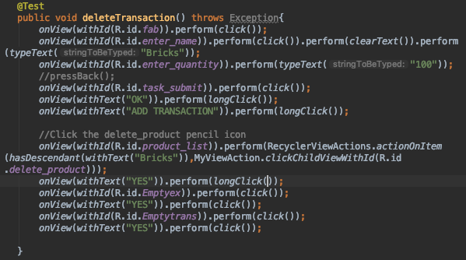
Delete Transaction
This test case runs successfully in creating an item in the Daily Transactions screen and its immediate deletion.

Slide 10
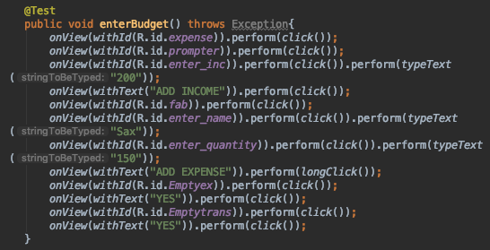
Enter Budget
This test case runs successfully in initializing total income then adding expenses to create a budget.

Slide 11
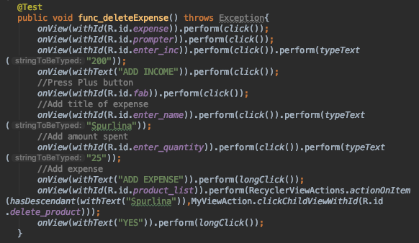
Delete Expense
This test case runs successfully in adding an expense to the budget then deleting it.

Slide 12
Cancel transaction
@Test
public void cancelTransaction() throws Exception{
onView(withId(R.id.fab)).perform(click());
onView(withId(R.id.enter_name)).perform(click())
.perform(clearText()).perform(typeText("Shoes"));
onView(withId(R.id.enter_quantity)).perform(typeText("200"));
onView(withText("CANCEL")).perform(click());
}
The application run as intended by the developers

Slide 13
Add Expense
@Test
public void sucessfulAddExpense() throws Exception{
onView(withId(R.id.expense)).perform(click());
onView(withId(R.id.prompter)).perform(click());
onView(withId(R.id.enter_inc)).perform(typeText("5000"));
onView(withText("ADD Income")).perform(click());
onView(withId(R.id.fab)).perform(click());
onView(withId(R.id.enter_name)).perform(click())
.perform(clearText()).perform(typeText("Shoes"));
onView(withId(R.id.enter_quantity)).perform(typeText("200"));
onView(withText("ADD EXPENSE")).perform(click());
}
The application run as intended by the developers

Slide 14
Cancel Expense
@Test
public void cancelExpense() throws Exception{
onView(withId(R.id.fab)).perform(click());
onView(withId(R.id.enter_name)).perform(click())
.perform(clearText()).perform(typeText("Shoes"));
onView(withId(R.id.enter_quantity)).perform(typeText("200"));
onView(withText("Cancel")).perform(click());
}
The application run as intended by the developers

Slide 15
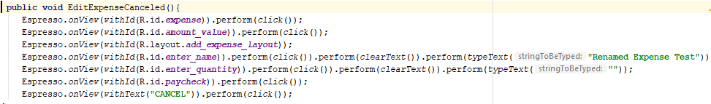
Editing an expense
App behaved as developers intended

Slide 16
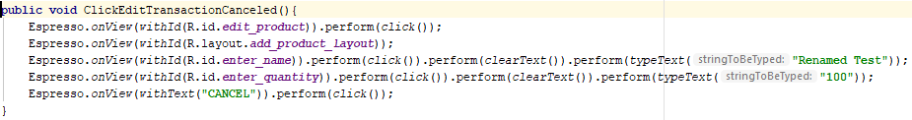
Edit Transaction
App behaved as developers intended

Slide 17
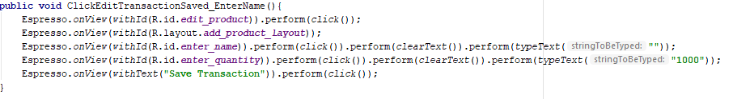
Edit Transaction
App behaved as developers intended

Slide 18
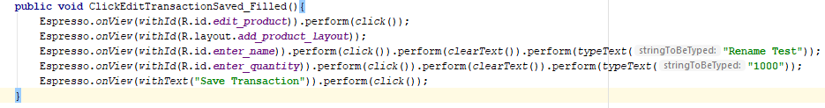
Edit Transaction
App behaved as developers intended

Slide 19
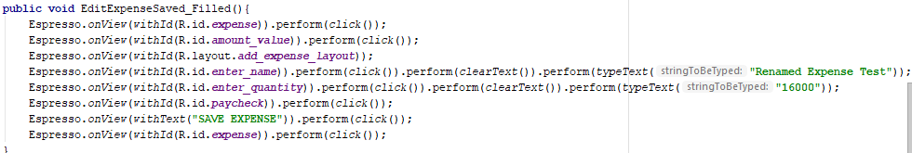
Edit Expense
Test Result: passed
Reason: app behaved as developers intended

Slide 20
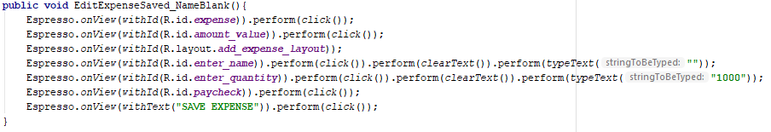
Edit Expenses
App behaved as developers intended

Slide 21
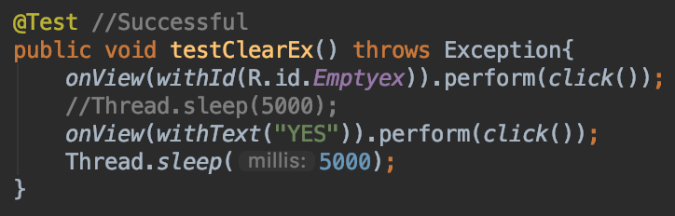
Clear Expenses
App behaved as developers intended

Slide 22
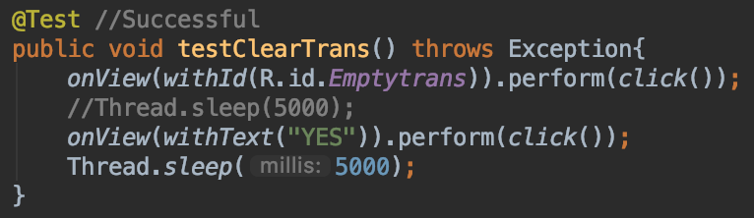
Clear Transactions
App behaved as developers intended

Slide 23
Unsuccessful Tests

Slide 24
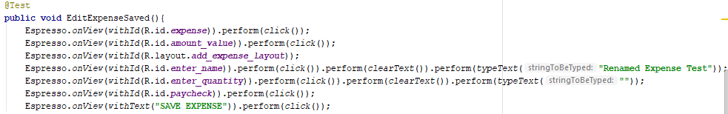
Editing an expense
Test Result: Failed
Reason: app crashes when the Quantity field is left blank
Suggestion: add a validator to check if this field is empty when the submit button is clicked

Slide 25
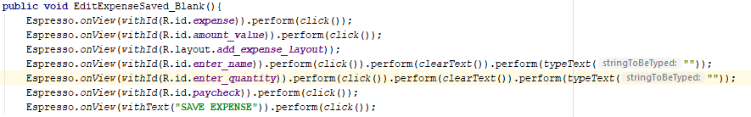
Edit Expense
Test Result: Failed
Reason: app crashes when the Quantity field is left blank
Suggestion: add a validator to check if this field is empty when the submit button is clicked

Slide 26
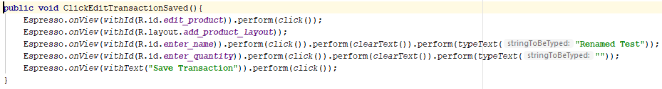
Edit Transaction
Test Result: Failed
Reason: app crashes when the Quantity field is left blank
Suggestion: add a validator to check if this field is empty when the submit button is clicked

Slide 27
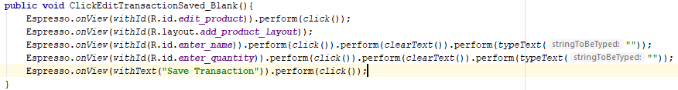
Edit Transaction
Test Result: Failed
Reason: app crashes when the Quantity and Name fields are left blank
Suggestion: add a validator to check if this field is empty when the submit button is clicked

Slide 28
Empty Amount Field //video
@Test
public void emptyAmountField() throws Exception{
onView(withId(R.id.fab)).perform(click());
onView(withId(R.id.enter_name)).perform(click())
.perform(clearText()).perform(typeText("Bag")); onView(withId(R.id.enter_quantity)).perform(typeText(""));
onView(withText("ADD TRANSACTION")).perform(click());
}
Test case to submit empty amount field
What happened: Application crashed and closed
Reason: Empty/void fields cannot be added to the database
Suggestions: Highlight the empty text fields prompting the user to make an input

Slide 29
Submit empty fields
@Test
public void emptyFields() throws Exception{
onView(withId(R.id.fab)).perform(click());
onView(withId(R.id.enter_name)).perform(click())
.perform(clearText()).perform(typeText(""));
onView(withId(R.id.enter_quantity)).perform(typeText(""));
onView(withText("ADD TRANSACTION")).perform(click());
}
Test case to submit empty text fields
What Happened: The application crashes and close
Reason: Empty/void fields cannot be added to the database
Suggestions: Highlight the empty text fields prompting the user to make an input

Slide 30
Submit empty Transaction field
@Test
public void emptyTransactionField() throws Exception{
onView(withId(R.id.fab)).perform(click());
onView(withId(R.id.enter_name)).perform(click())
.perform(clearText()).perform(typeText(""));
onView(withId(R.id.enter_quantity)).perform(typeText("300"));
onView(withText("ADD TRANSACTION")).perform(click());
}
Test case to submit empty Transaction field
What happened: Toast pop up to check input values
Problem: Program did not give the user a chance to correct errors and try again it instead end the action
Suggestions: Highlight missing text fields prompting the user to finish their action
Notes:
Is this an error though or just a preference?

Slide 31
Entering a large number //video
@Test
public void largeAmount() throws Exception{
onView(withId(R.id.fab)).perform(click());
onView(withId(R.id.enter_name)).perform(click())
.perform(clearText()).perform(typeText("Slippers"));
onView(withId(R.id.enter_quantity)).perform(typeText("123456789101116921314151161718191206978525"));
onView(withText("ADD TRANSACTION")).perform(click());
}
Test case to submit A large number
What happens: Application crashes and close. Application cannot be opened again has to be uninstalled.
Reason: Database can only store fields with a limited parameter.
Suggestions: restrict the user to enter a limited value

Slide 32
Empty Income Field
@Test
public void emptyIncomeField() throws Exception {
onView(withId(R.id.expense)).perform(click());
Thread.sleep(700);
onView(withId(R.id.prompter)).perform(click());
Thread.sleep(700);
onView(withId(R.id.enter_inc)).perform(typeText(""));
Thread.sleep(700);
onView(withText("ADD Income")).perform(click());
Thread.sleep(700);
}
Test case to submit empty income field
What happened: Application Accepts an empty income field
Problem: This is a logical error.
Suggestions: Prompt the user to enter an actual value for income if field is empty on submit.

Slide 33
Entering Income then Changing Page
@Test
public void pageChange() throws Exception{
onView(withId(R.id.expense)).perform(click());
onView(withId(R.id.prompter)).perform(click());
onView(withId(R.id.enter_inc)).perform(typeText("5000"));
onView(withText("ADD Income")).perform(click());
onView(withId(R.id.income)).perform(click());
onView(withId(R.id.expense)).perform(click());
onView(withId(R.id.enter_inc)).perform(typeText("4000"));
onView(withText("ADD Income")).perform(click());
}
Test case to submit an income then change page
What happened: The entered income is not accepted and the process is restarted..
Suggestions: Record the entered income and allow the user to continue the process unless they choose to cancel.

Slide 34
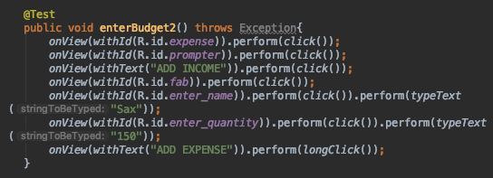
Entering a Budget - Error Case 1
What happened:
No income was provided and an attempt to add an expense was executed resulting in a crash
Suggestions:
Implement a try/catch block to force the user to enter a valid income

Slide 35
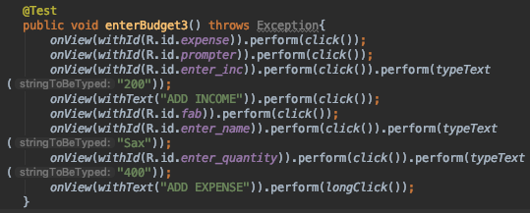
Enter a Budget - Error Case 2
What happened:
An expense greater than the income was accepted. No warning or error checking prevented this data entry.
Suggestions:
Implement an error check to force the user to enter an expense less than the total income

Slide 36
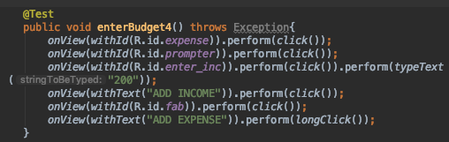
Enter a Budget - Error Case 3
What happened:
After an expense was added, an attempt was made to add an expense with empty form fields causing a crash
Suggestions:
Implement a try/catch block to force the user to enter a name and a valid expense cost.

Slide 37
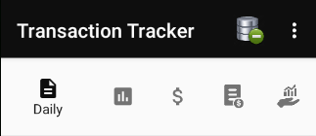
Absence of UI Option to Wipe Database
User Interface Adaptivity
What happened: The application was launched on a display with smaller screen real estate
Suggestions: Adjust the menu to prove these clearing options in the 3 dot drop down menu

Slide 38
User-Friendliness and Database Integrity

Slide 39
Test Summary
Add transaction
Delete transaction
Edit transaction
Delete all transactions
Cancel transaction
Enter budget
Calculate lost of item
Add expense
Edit expense
Cancel expense
Delete expense

Slide 40


Other Testing Frameworks

Slide 41
Questions

